Slide 1


Titolo presentazione sottotitolo
Software Engineering 2
RASD
Milano, XX mese 20XX
Lo Bianco Riccardo, Manzoni Mirco, Mascellaro Giuseppe
A.A. 2016/2017
Professor Di Nitto Elisabetta

Slide 2
PowerEnJoy
PowerEnJoy is a car sharing service that exclusively employs electric cars.
The company is in need of a system that allows users to find the locations of available cars located in the geographical areas they choose to explore.

Slide 3
Goals
[G1] Whenever a user needs to rent a car, he can do it for a fixated price.
[G2] Whenever a user wants to use a car, nobody else can use that car at the same time.
[G3] Let users and and reach cars.
[G4] Let drivers find and reach safe parking areas and locations.
[G5] Encourage the sharing of a single car.
[G6] Keep cars battery at a level such that they can be used for the greatest possible amount of time.
[G7] Keep cars always well distributed on the territory.
[G8] Make sure that most of the cars are ready to be used and in a good condition.
[G9] Identify who the driver is for security purposes.

Slide 4
Domain assumption (1)
[D1] Personal information provided in the sign up phase are true.
[D2] Cars are always connected to PowerEnJoy VPN (Virtual Private Network).
[D3] Cars’ GPS is never neither switched off nor damaged.
[D4] Cars’ locations are known by GPS.
[D5] Users who have an open reservation are properly located by GPS through their mobile devices.
[D6] Payments management is delegated to a third party company.
[D7] All sensors report correct information and they are neither switched off nor damaged.

Slide 5
Domain assumption (2)
[D8] Every possible technical issue is detected by the sensors.
[D9] Each power plug can be linked to at most one car at the same time.
[D10] Power grid stations always dispense electricity.
[D11] Cars’ screens are never switched off nor damaged.
[D12] The number of available slots in a special parking area is always known by PowerEnJoy though its VPN.
[D13] The user who inserts his password on the screen is the same who actually drives the car.

Slide 6
G1: requirements
[G1] Whenever a user needs to rent a car, he can do it for a fixated price.
[R1] Sign up functionality.
[R2] Verification of driving license and payment information.
[R3] Log in functionality.
[R4] Prevention of car doors unlocking unless the user is into a 10m range.
[R5] Start charging expenses for a given amount of money per minute as soon as the engine is ignited.
[R6] Charging of expenses on the user's account after the end of each ride.
[R7] Consult last rides' invoices.

Slide 7
G9: requirements
[G9] Identify who the driver is for security purposes.
[R1] The user who unlocks the car doors must enter his personal password once in the car in order to be recognized.
[R2] Every time the user wants to ignite the engine, he must be recognized.
[R3] Every time the driver exits the car, the engine goes o after 15 seconds.
[R4] An operator can watch all drivers driving a certain car in every moment and, in case of necessity, he can send this information to recognized external authorities (like police and or medical services).
[R5] The user can ask for a new password.
[R6] A ride can last for at most eight hours. After that, the public safety service is informed about a potential robbery.

Slide 8
Actor identifying
Guest: a person who can access a limited number of the PowerEnJoy’s features, e.g. the research tool. They can neither make reservations nor access to any features that requires the possibility of online payments.
User: a person who has registered and therefore has provided his personal and payment information.
Driver: a user who has made a reservation for a car and now is driving it.
Operator: a person who takes care of cars’ maintenance and picks up various kinds issues when they happened.

Slide 9
Start ride: use cases (1)
Actor | User
Goal | [G1] [R4] [R5] [G9] [R1] [R2]
Precondition | The user has an active reservation for a car.
Event Flow | 1. The user launches the car doors unlock command. 2. PowerEnJoy detects the user's position using the GPS. 3. PowerEnJoy unlocks car doors. 4. The user enters his password through the car's screen. 5. PowerEnJoy recognizes the user. 6. The user ignites the engine for the first time.
Post-Condition | The ride starts. The user becomes a driver. Start counting expenses for a given amount of money per minute. The driver can drive the car.

Slide 10
Start ride: use cases (2)
Exception | a. The user is too far from the car. b. The wrong password is inserted five times. c. The car is linked to a power turret.
Exception Handling | (a) Prevent car doors unlock. (b) PowerEnJoy prevents further password insertion and the user has the possibility to exit the car within five minutes from the car doors unlock otherwise he starts paying the C fee. Then, the car doors lock, the reservation expires, the car status is switched to available and an invoice reporting expenses is generated. (c) Once the car doors are unlocked, the user has also to unplug the car from the power turret, otherwise the engine does not ignite.

Slide 11
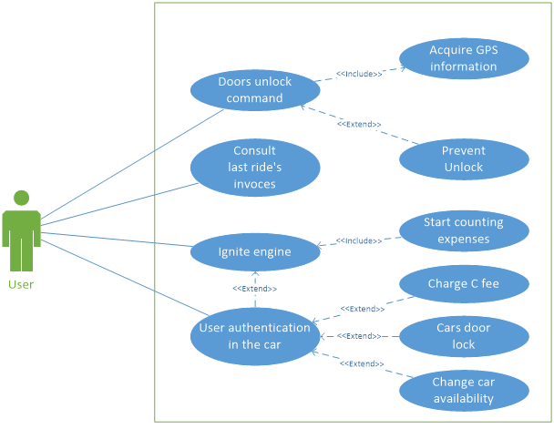
Start ride: use cases diagram

Slide 12
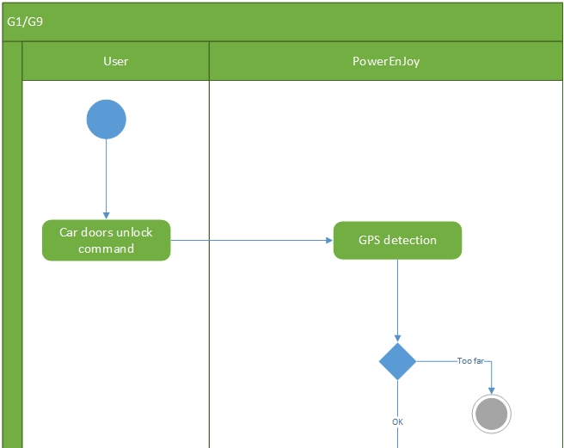
Start ride: activity diagram (1)

Slide 13
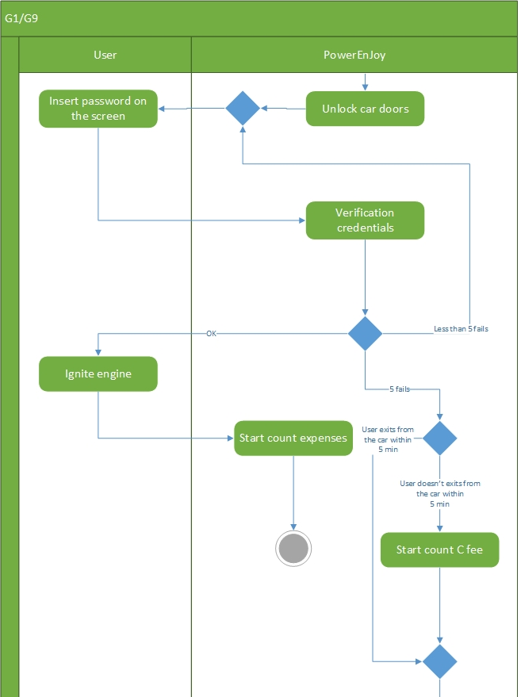
Start ride: activity diagram (2)

Slide 14
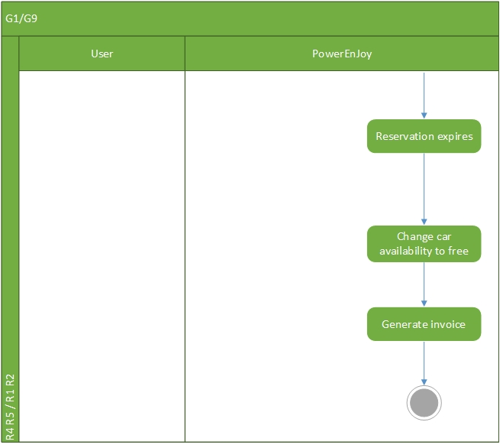
Start ride: activity diagram (3)

Slide 15
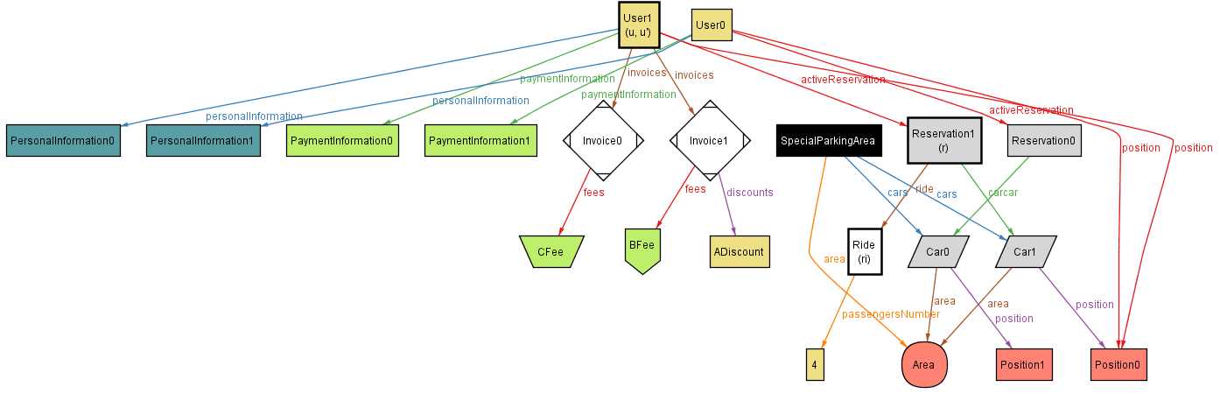
Start ride: Alloy modeling

Slide 16
References
RASD.pdf
…

